Slide 1
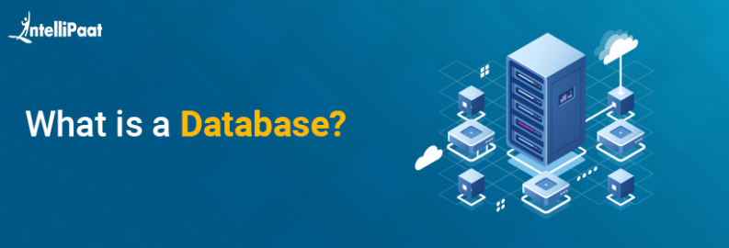
Introduction to Databases
WHAT IS A DATABASE
A database is an organized collection of structured information, or data, typically stored electronically in a computer system. A database is usually controlled by a database management system DBMS. Together, the data and the DBMS, along with the applications that are associated with them, are referred to as a database system, often shortened to just database.

Slide 2
They are 3 Relational Database Management Systems For Data Newbies To Get Started On
*)Relational DataBase Management Systems (RDBMS)
A relational database management system (RDBMS) is a collection of programs and capabilities that enable IT teams and others to create, update, administer and otherwise interact with a relational database. RDBMSes store data in the form of tables, with most commercial relational database management systems using Structured Query Language (SQL) to access the database. However, since SQL was invented after the initial development of the relational model, it is not necessary for RDBMS use.

Slide 3
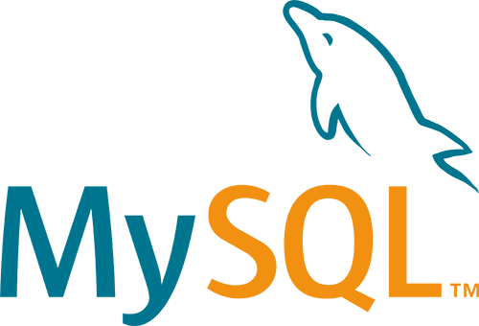

1) MySQL
MySQL is a relational database management system (RDBMS) developed by Oracle that is based on structured query language (SQL). A database is a structured collection of data. It may be anything from a simple shopping list to a picture gallery or a place to hold the vast amounts of information in a corporate network.
2) PostgreSQ
PostgreSQL, often simply Postgres, is an object-relational database management system available for many platforms including Linux, FreeBSD, Solaris, Microsoft Windows and Mac OS X. It is released under the PostgreSQL License, which is an MIT-style license, and is thus free and open source software

Slide 4
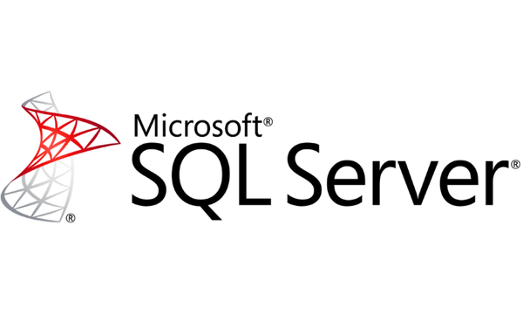
3) Microsoft SQL Server
SQL Server is Microsoft's relational database management system (RDBMS). It is a full-featured database primarily designed to compete against competitors Oracle Database (DB) and MySQL. Like all major RBDMS, SQL Server supports ANSI SQL, the standard SQL language.
4)comparison between the three RDBMS
For now, MySQL doesn't come close to making the most out of memory-optimized tables. PostgreSQL doesn't support in-memory database creation. SQL Server uses an optimistic strategy to handle memory-optimized tables, which means they can participate in transactions along with ordinary tables.

Slide 5
Which Should I Choose To Best Help My Career?
If you are using any of these three to build up some skills in setting up tables and schemas, building some ETL routines to load data then doing some basic reporting you will find those skills transfer easily across all three.
For websites and working online I’ve predominantly used MySQL over the years.
In industry, earlier in my career especially, I used SQL Server a lot and again a few years ago when I built a sports betting analytics system.
The exact tool or DBMS isn’t really the point at this stage though, it’s the skills and basic understanding of how relational databases work that you need to get more experience with and I’ll cover more of that in future posts.

